Slide 1
Welcome to the experiment!

Slide 2
Experiment instruction
This experiment will have three sessions.
In the first session, you will hear one word on each trial. Press F key on the keyboard by your left index finger if you hear the word showed on the left. Press J key by your right index finger if you hear the word showed on the right. If you are not sure, please make the best guess as you can.

Slide 3
Experiment instruction
This experiment will have three sessions.
In the first session, you will hear one word on each trial. Press F key on the keyboard by your left index finger if you hear the word showed on the left. Press J key by your right index finger if you hear the word showed on the right. If you are not sure, please make the best guess as you can.
In the second session, you will hear either “Lap” or “Lab” word on each trial. Press F key on the keyboard by your left index finger if you hear “Lap”. Press J key by your right index finger if you hear “Lab”. If you are not sure, please make the best guess as you can.

Slide 4
Experiment instruction
This experiment will have three sessions.
In the first session, you will hear one word on each trial. Press F key on the keyboard by your left index finger if you hear the word showed on the left. Press J key by your right index finger if you hear the word showed on the right. If you are not sure, please make the best guess as you can.
In the second session, you will hear either “Lap” or “Lab” word on each trial. Press F key on the keyboard by your left index finger if you hear “Lap”. Press J key by your right index finger if you hear “Lab”. If you are not sure, please make the best guess as you can.
In the third session, on each trial, you will hear a series of tones followed by a word. Like in the second session, press F key on the keyboard by your left index finger if you hear “Lap”. Press J key by your right index finger if you hear “Lab”. If you are not sure, please make the best guess as you can.

Slide 5

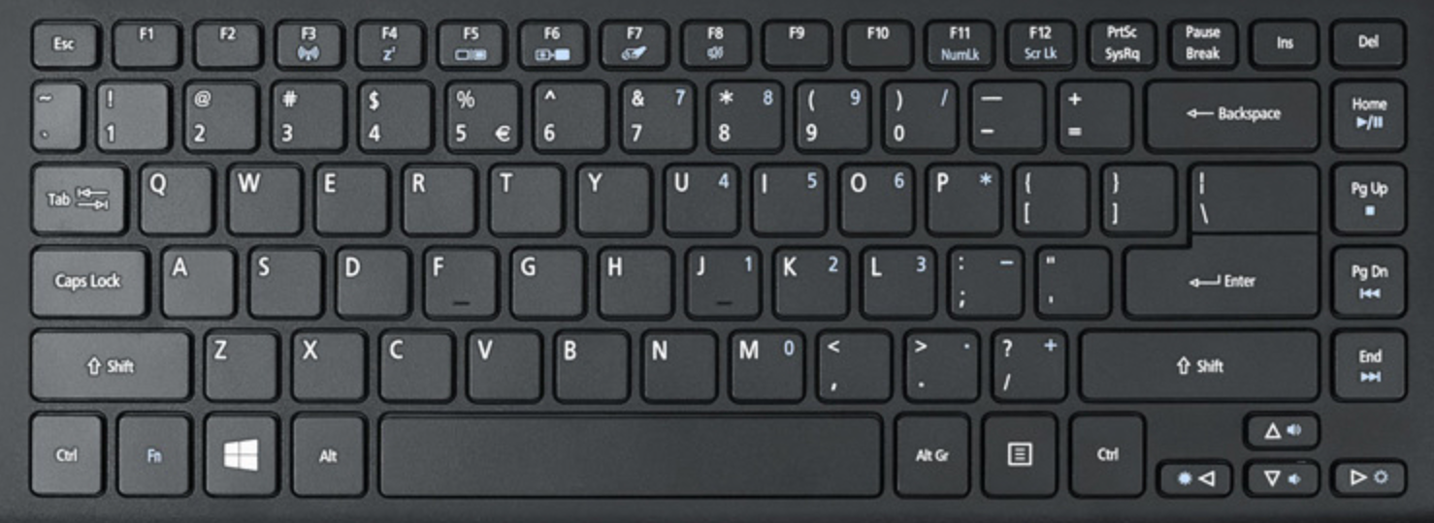
1st Session
/Cap/
F: /Cap/, J: /Cab/

Slide 6
1st Session
/Cab/
F: /Cap/, J: /Cab/

Slide 7
2nd Session
/Lap/
F: /Lap/, J: /Lab/

Slide 8
2nd Session
/Lab/
F: /Lap/, J: /Lab/

Slide 9
Main task
/Lap/
0
0.6
1.2
1.8
2.4
3.0
3.6
F: /Lap/, J: /Lab/

Slide 10
Main task
/Lab/
0
0.6
1.2
1.8
2.4
3.0
3.6
F: /Lap/, J: /Lab/

